Slide 1
Insertion Sort
Sorted
Unsorted
0
1
2
3
4
3
5
2
6
4
Notes:
Insertion sort is one way to sort an array of numbers. Data is divided into sorted and unsorted portions. One by one, the unsorted values are inserted into their appropriate positions in the sorted subarray.

Slide 2
All values start as Unsorted
Sorted
Unsorted
0
1
2
3
4
3
5
2
6
4
Notes:
Let's use insertion sort to sort the elements of this array in ascending order.
Insertion sort relies on breaking up the array into sorted and unsorted portions.
Before we start sorting, all values are considered unsorted.

Slide 3
Add first value to Sorted
Sorted
Unsorted
0
1
2
3
4
3
5
2
6
4
Notes:
On our first pass, we'll take the first unsorted value (3) and insert it into the sorted subarray. 3 is now the start and end of our sorted subarray.

Slide 4
5 > 3
insert 5 to right of 3
Sorted
Unsorted
0
1
2
3
4
3
5
2
6
4
Notes:
Since 5 > 3, we'll insert it to the right of 3 in our sorted subarray.

Slide 5
2 < 5 and 2 < 3
shift 3 and 5
insert 2 to left of 3
Sorted
Unsorted
0
1
2
3
4
3
5
2
6
4
Notes:
Next we'll work on inserting 2 to our sorted subarray.
We'll compare 2 to the values in the sorted subarray from right to left to find it's correct sorted position. We see that 2 < 5 and 2 < 3. We've reached the beginning of the sorted subarray, so we know that 2 must be inserted to the left of 3. This forces us to shift 3 and 5 rightwards to make room for 2.

Slide 6
6 > 5
insert 6 to right of 5
Sorted
Unsorted
0
1
2
3
4
2
3
5
6
4
Notes:
6 is an easy one. 6 > 5, so it can be inserted to the right of 5.

Slide 7
4 < 6, 4 < 5, and 4 > 3
shift 5 and 6
insert 4 to right of 3
Sorted
Unsorted
0
1
2
3
4
2
3
5
6
4
Notes:
4 < 6 and 4 < 5, but 4 > 3. Therefore, we know that 4 must be inserted to the right of 3.
Again, we are forced to shift 5 and 6 rightwards to make room for 4.

Slide 8
For each unsorted element n:
1. Determine where in sorted portion of the list to insert n
2. Shift sorted elements rightwards as necessary to make room for n
3. Insert n into sorted portion of the list
Notes:
In summary, here's the insertion sort algorithm:
Take each unsorted element, n, and compare it to values in the sorted subarray from right to left until you determine the appropriate sorted position for n.
Shift sorted elements rightward as necessary to make space for n, and insert the previously unsorted n into its appropriate position in the sorted subarray.

Slide 9
for i = 0 to n - 1
element = array[i]
j = i
while (j > 0 and array[j - 1] > element)
array[j] = array[j - 1]
j = j - 1
array[j] = element
Notes:
And here's some pseudocode to implement insertion sort in C. Try it yourself!

Slide 10
What's the worst case runtime of insertion sort?
What's the best case runtime of insertion sort?
Lin
Notes:
In the worst case, we'd make one comparison for the second element, two comparisons for the third element, and so on. We'd end up with O(n²).
In the best case, we'd run insertion sort on an already sorted list. The sorted portion would simply be built up from left to right without a large number of comparisons and no complicated shifting of elements so best case runtime would be Ω(n).
What would the best case runtime of insertion sort be if we iterated through the sorted portion of the list from left to right (rather than right to left) when determining where to insert the next unsorted element?
n²

Slide 11
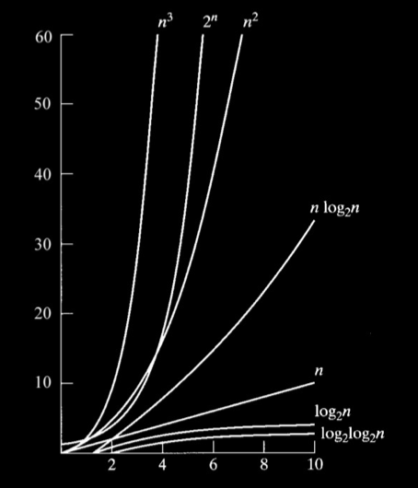
Notes:
Although insertion sort and selection sort are very similar, you can see that insertion sort's best case runtime, n, is significantly more efficient than selection sort's best case runtime, n².

Slide 12
Bubble Sort
Selection Sort
Insertion Sort
Merge Sort
O
n²
n²
n²
nlogn
Ω
n
n²
n
nlogn
Θ
n²
nlogn
Notes:
Here's a comparison of the runtimes of insertion sort to the runtimes of other sorting algorithms covered in CS50.

